Slide 1


Introduction to Generalised Low-Rank Model and Missing Values
Jo-fai (Joe) Chow
Data Scientist
joe@h2o.ai
@matlabulus
Based on work by Anqi Fu, Madeleine Udell, Corinne Horn,
Reza Zadeh & Stephen Boyd.

Slide 2

About H2O.ai
H2O in an open-source, distributed machine learning library written in Java with APIs in R, Python, Scala and REST/JSON.
Produced by H2O.ai in Mountain View, CA.
H2O.ai advisers are Trevor Hastie, Rob Tibshirani and Stephen Boyd from Stanford.

Slide 3
About Me
2005 - 2015
Water Engineer
Consultant for Utilities
EngD Research
2015 - Present
Data Scientist
Virgin Media
Domino Data Lab
H2O.ai

Slide 4
About This Talk
Overview of generalised low-rank model (GLRM).
Four application examples:
Basics.
How to accelerate machine learning.
How to visualise clusters.
How to impute missing values.
Q & A.

Slide 5
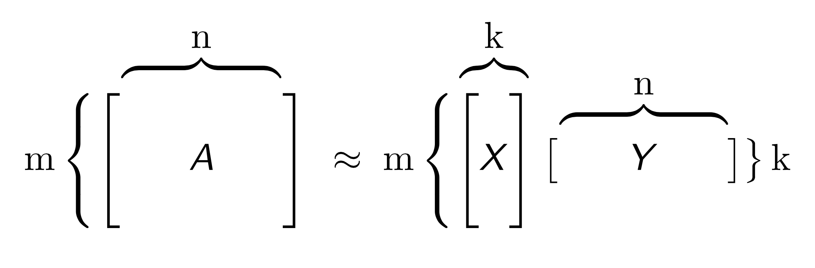
GLRM Overview
GLRM is an extension of well-known matrix factorisation methods such as Principal Component Analysis (PCA).
Unlike PCA which is limited to numerical data, GLRM can also handle categorical, ordinal and Boolean data.
Given: Data table A with m rows and n columns
Find: Compressed representation as numeric tables X and Y where k is a small user-specified number
Y = archetypal features created from columns of A
X = row of A in reduced feature space
GLRM can approximately reconstruct A from product XY
Memory Reduction / Saving
≈
+

Slide 6
GLRM Key Features
Memory
Compressing large data set with minimal loss in accuracy
Speed
Reduced dimensionality = short model training time
Feature Engineering
Condensed features can be analysed visually
Missing Data Imputation
Reconstructing data set will automatically impute missing values

Slide 7
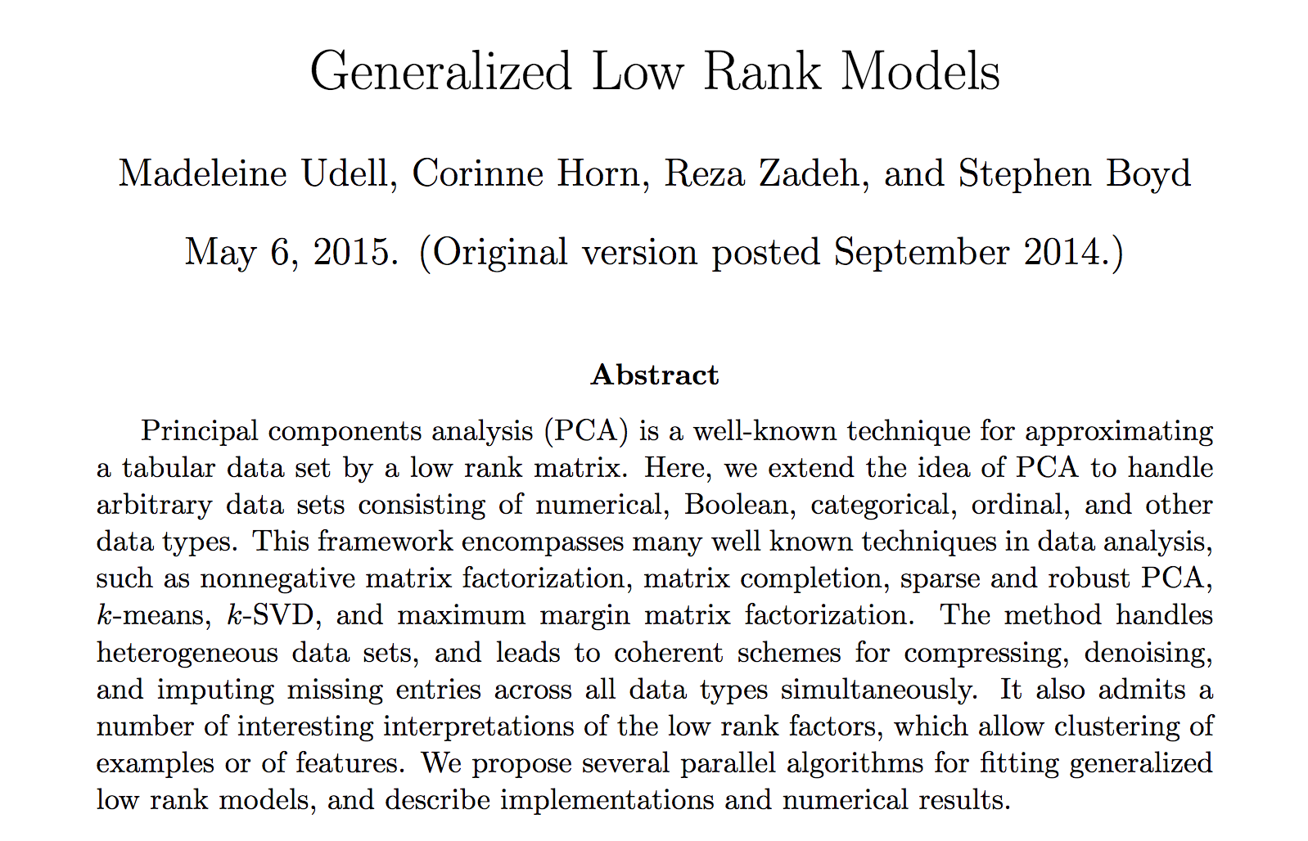
GLRM Technical References
Paper
arxiv.org/abs/1410.0342
Other Resources
H2O World Video
Tutorials

Slide 8
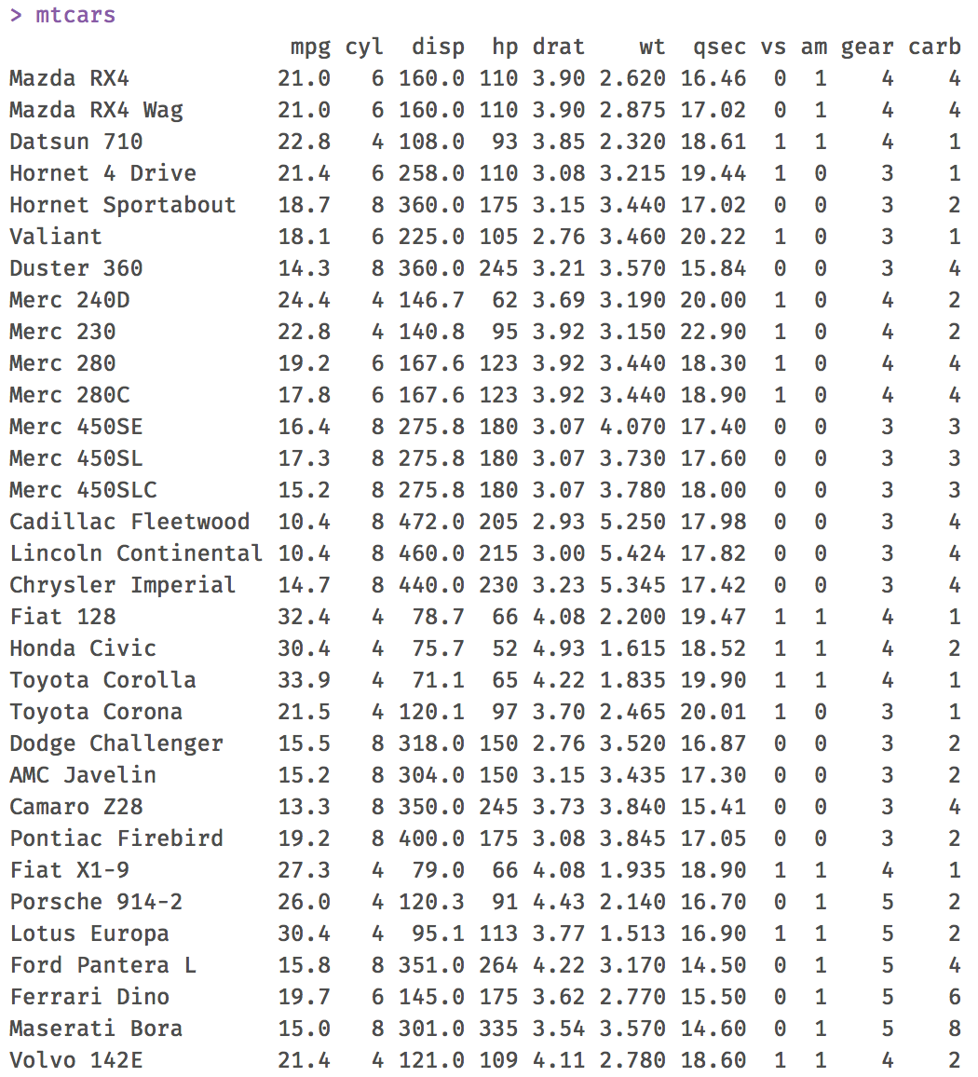
Example 1: Motor Trend Car Road Tests
n = 11
“mtcars” dataset in R
Original Data Table
A
m = 32

Slide 9
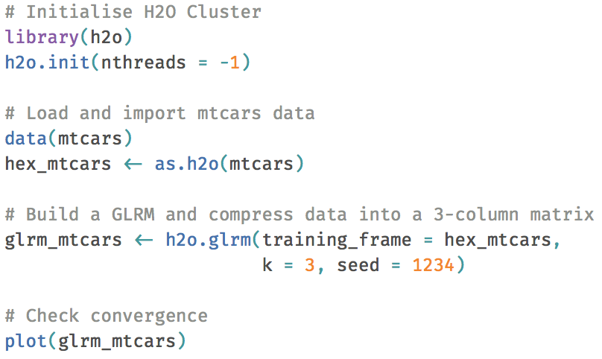
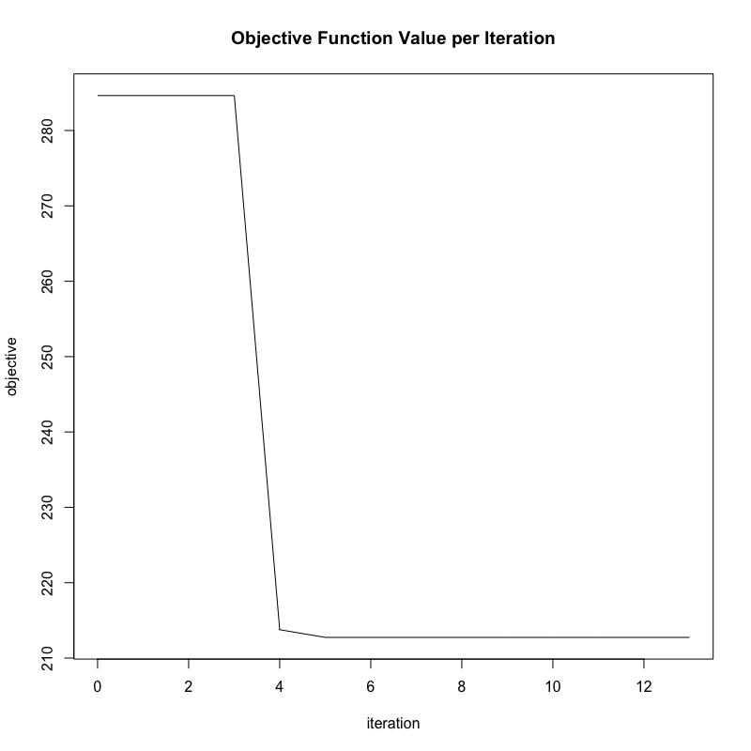
Example 1: Training a GLRM

Slide 10
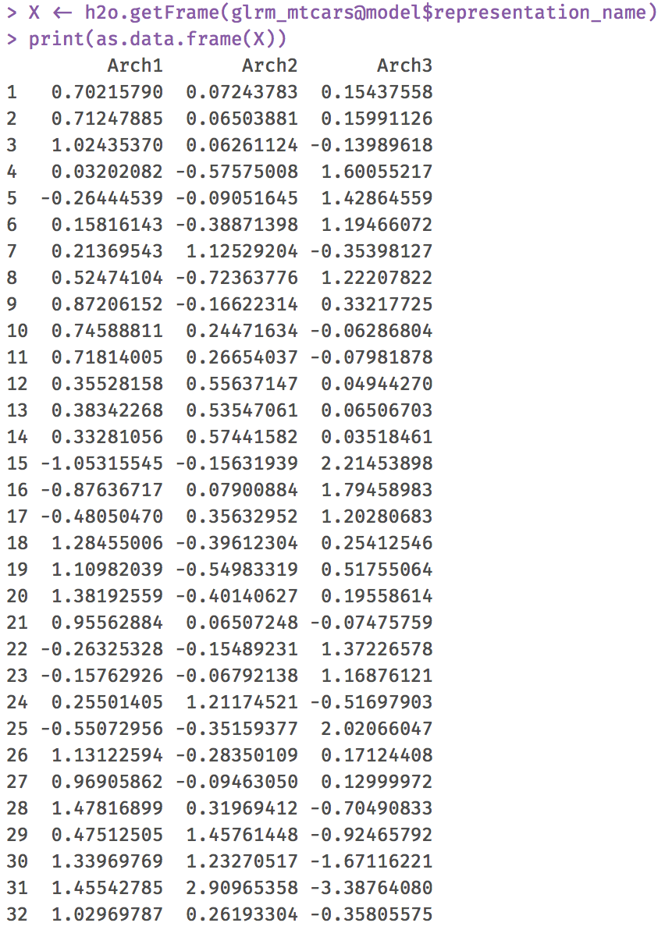
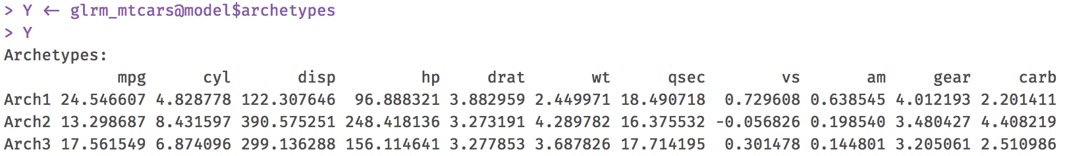
Example 1: X and Y from GLRM
3
11
3
Y
X
32

Slide 11
Example 1: Summary
A
X
Y
≈
Memory Reduction / Saving
≈
+

Slide 12
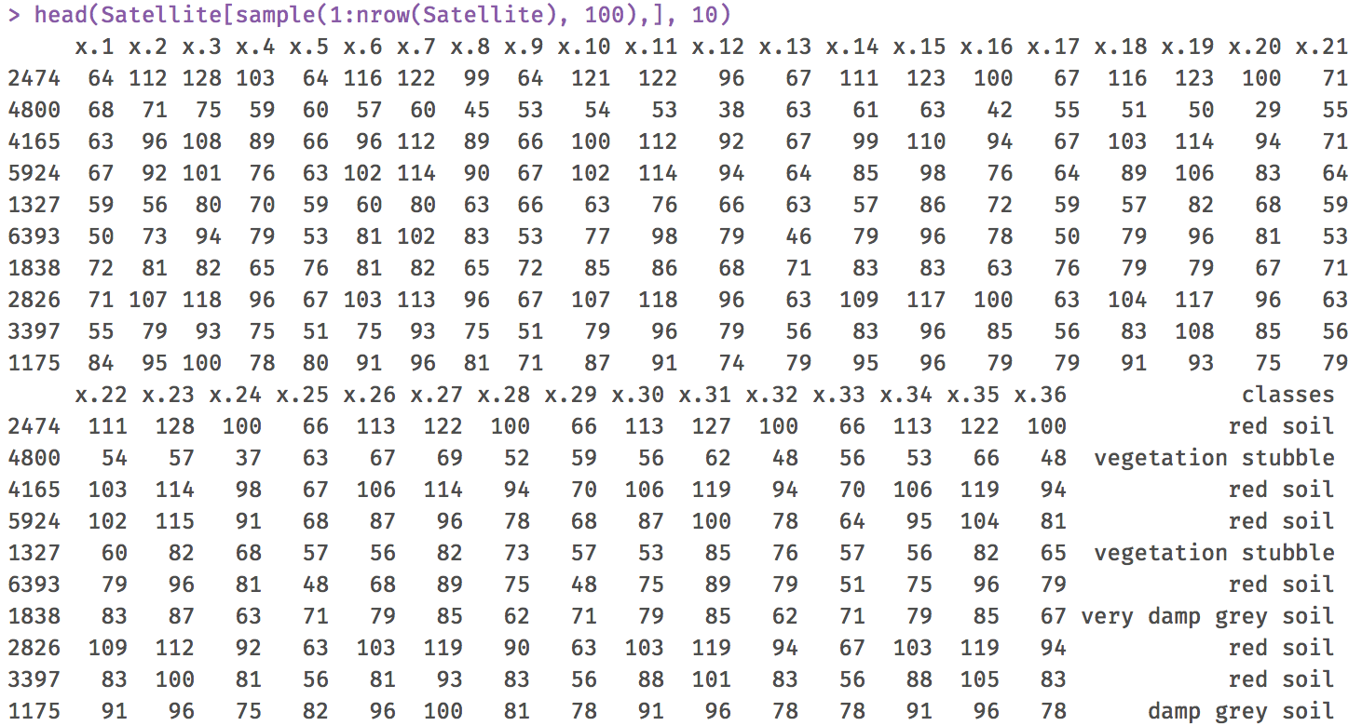
Example 2: ML Acceleration
About the dataset
R package “mlbench”
Multi-spectral scanner image data
6k samples
x1 to x36: predictors
Classes:
6 levels
Different type of soil
Use GLRM to compress predictors

Slide 13
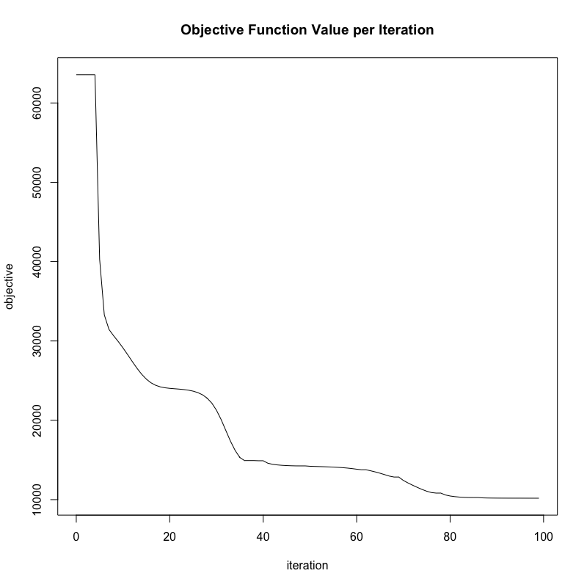
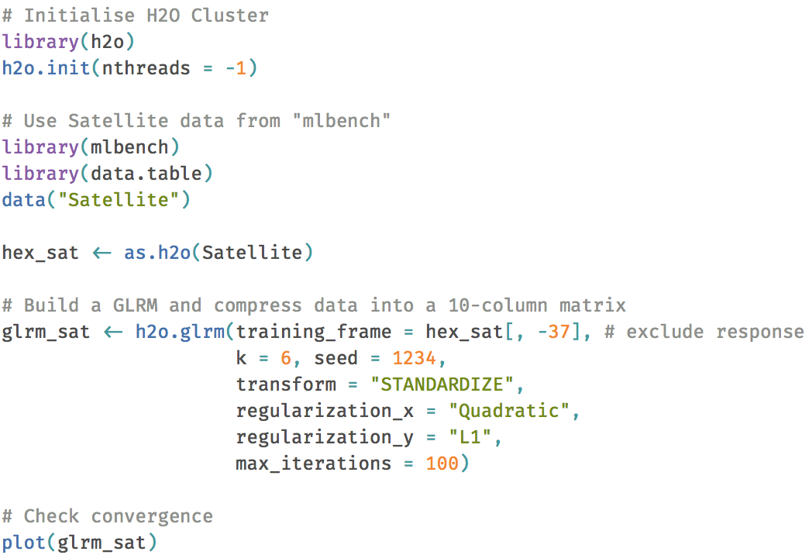
Example 2: Use GLRM to Speed Up ML
k = 6
Reduce to 6 features

Slide 14
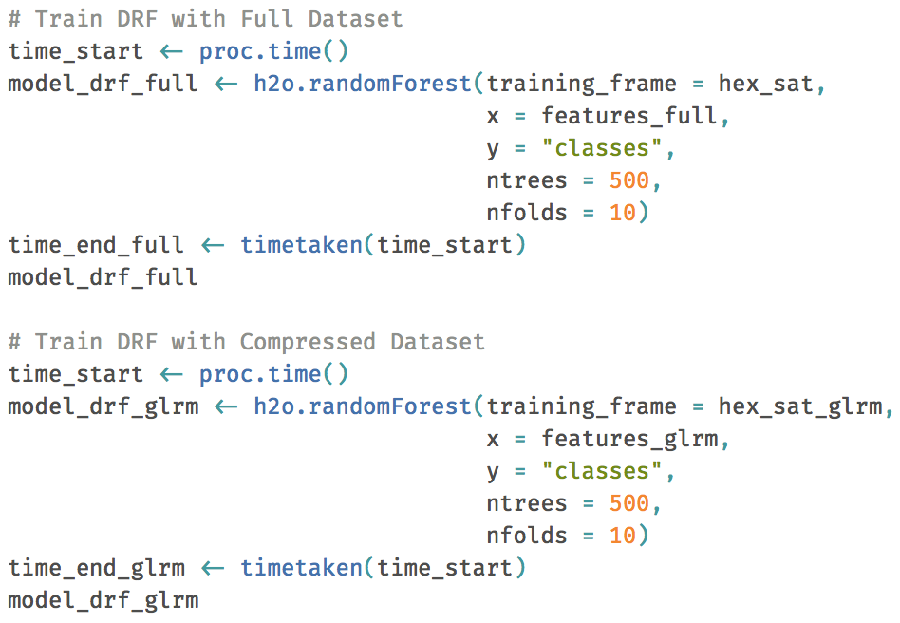
Example 2: Random Forest
Train a vanilla H2O Random Forest model with …
Full data set (36 predictors)
Compressed data set (6 predictors)

Slide 15
Example 2: Results Comparison
Data | Time | 10-fold Cross Validation
 |  | Log Loss | Accuracy
Raw data (36 Predictors) | 4 mins 26 sec | 0.24553 | 91.80%
Data compressed with GLRM (6 Predictors) | 1 min 24 sec | 0.25792 | 90.59%
Benefits of GLRM
Shorter training time
Quick insight before running models on full data set

Slide 16
Example 3: Clusters Visualisation
About the dataset
Multi-spectral scanner image data
Same as example 2
x1 to x36: predictors
Use GLRM to compress predictors to 2D representation
Use 6 classes to colour clusters

Slide 17
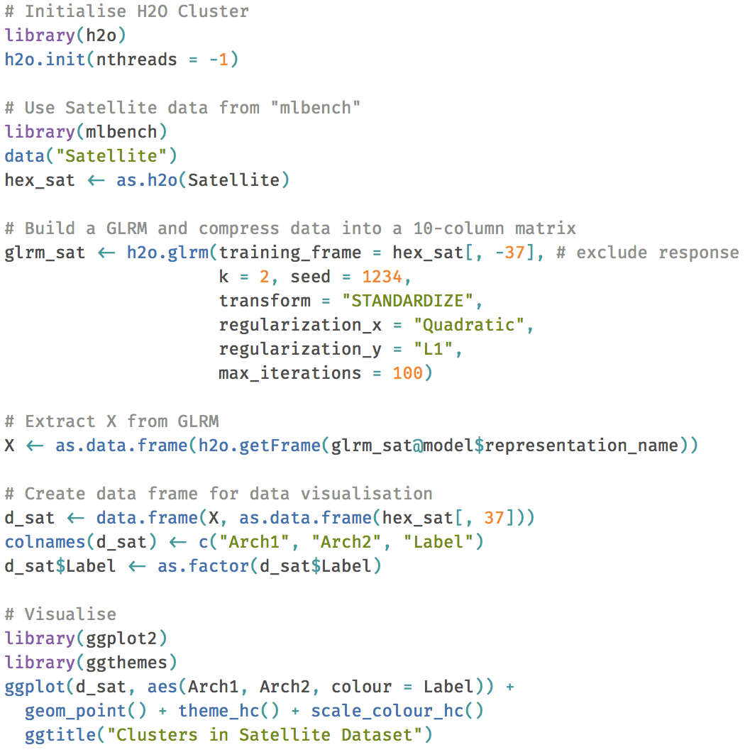
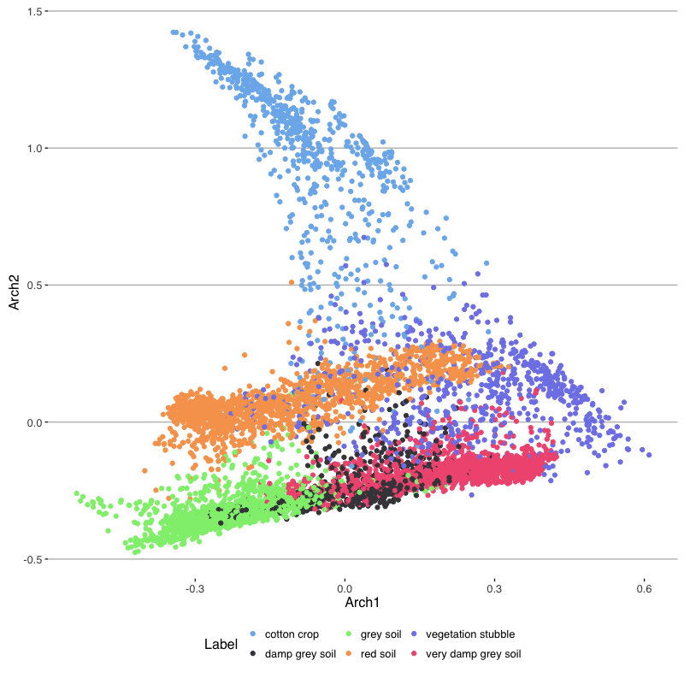
Example 3: Clusters Visualisation

Slide 18

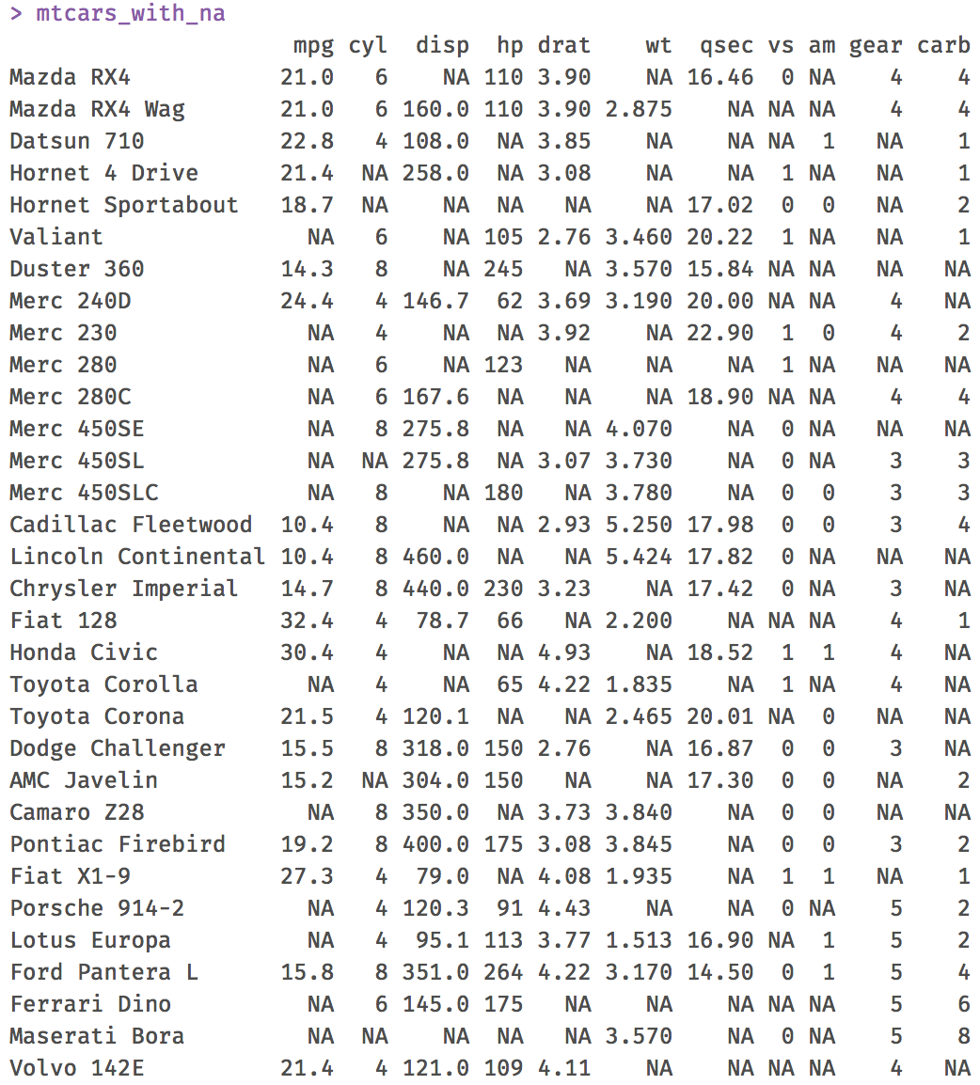
Example 4: Imputation
”mtcars” – same dataset for example 1
Randomly introduce 50% missing values

Slide 19

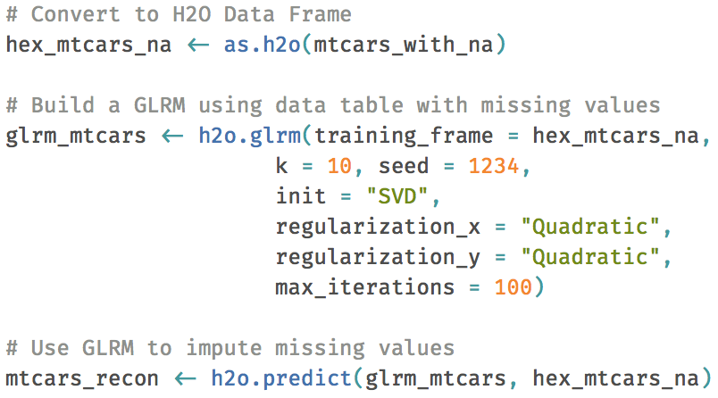
Example 4: GLRM with NAs
When we reconstruct the table using GLRM,
missing values are automatically imputed.

Slide 20
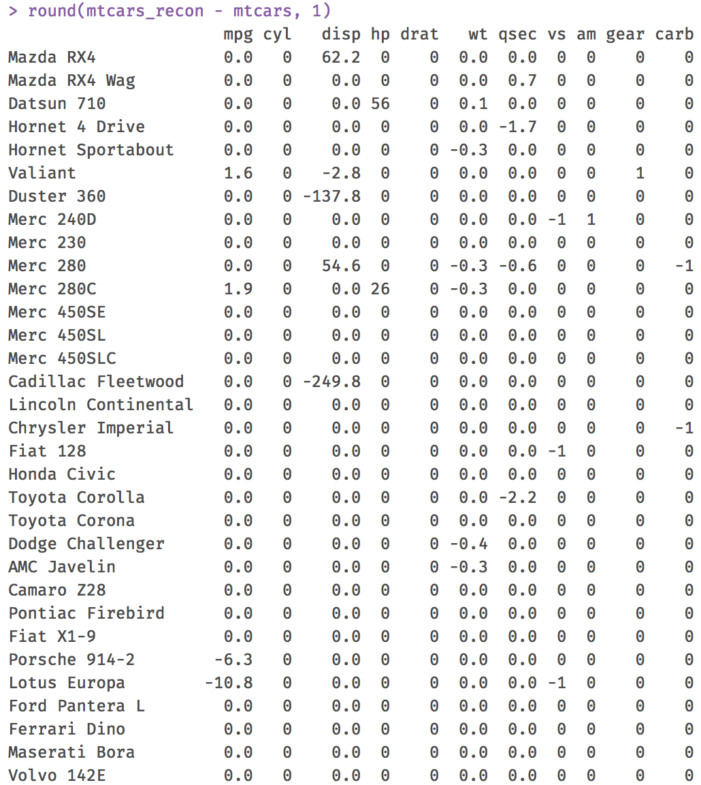
Example 4: Results Comparison
Absolute difference between original and
imputed values.
We are asking GLRM to do a difficult job
50% missing values
Imputation results look reasonable

Slide 21
Conclusions
Use GLRM to
Save memory
Speed up machine learning
Visualise clusters
Impute missing values
A great tool for data pre-processing
Include it in your data pipeline

Slide 22
Any Questions?
Contact
joe@h2o.ai
@matlabulous
github.com/woobe
Slides & Code
github.com/h2oai/h2o-meetups
H2O in London
Meetups / Office (soon)
www.h2o.ai/careers
H2O Help Docs & Tutorials
www.h2o.ai/docs
university.h2o.ai

